Slide 1
Directional Sprites
IN628 Intermediate Architectures and Algorithms
Semester 2, 2016
Notes:
There’s a detailed handout for this as well, but it’s tricky so we will discuss it first

Slide 2
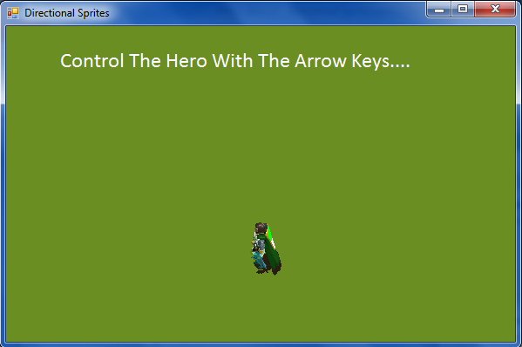
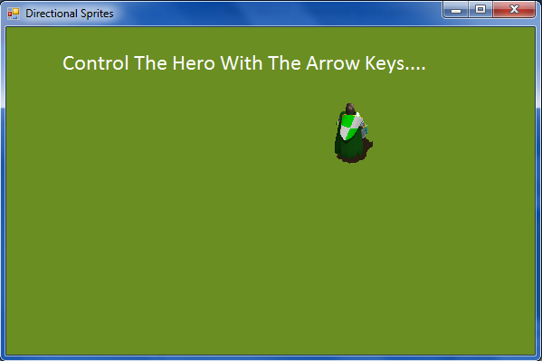
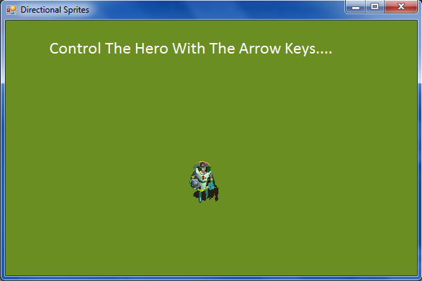
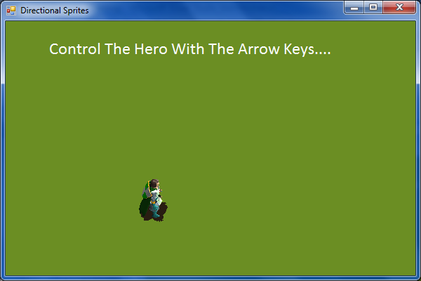
Directional Movement
Notes:
To look realistic, your sprite will need different sprite sheets for movement in the different compass directions (e.g. walking left or right (West/East), walking toward or away from the viewer (South/North).
How will your sprite manage multiple sprite sheets? There are always two issues: 1) storage and 2) computation/use
Storage
As always when you have a small, fixed number of elements of the same type, you can use an array.
The different sprite sheet bitmaps can be stored in an array of Bitmaps: array<Bitmap^>^ spriteSheets;
Computation/use
We return to the notion of “state variables”. Like isAHamster in the Gnome game, state variables tell us about the current condition (state) of an object. We need to add a state variable to our Sprite
You maintain a variable to keep track of which direction your sprite is moving. For this exercise, we need to be able to hold four values.
What data type should it be? To decide this, you need to think ahead just a little.
Remember that our spriteSheets are stored in an array. We will change animations by selecting different elements from the array, one for each direction.
Therefore, we would like to have our state variable be something we can use to index into an array.
That means an int (or equivalent – enum type of defined constants – we will see an example in a minute)
You can then use the variable to index into the Bitmap array.

Slide 3




Multiple Spritesheets
From www.reinerstilesets.de/2d-grafiken/
Notes:
These are the sheets we will use for this week’s practical
You can see his feet move
Think of this as the array of four Bitmaps, with locations 0,1,2,3
What changes must you make to your Sprite class from Blobbo?
First, let’s assume that you have somehow figured out which of these spriteSheets to use (we come back to this in a minute)
The updateFrame is identical.
The erase is identical
Move and Draw need to change. He needs the correct Bitmap for Draw, and he needs the correct values to modify xPos and yPos by for Move so that he moves in the correct compass direction.
We’ll talk about the Draw first
The draw’s command to the canvas is identical – all that figuring out the rectangle and so forth.
But instead of having a single spritesheet variable that you always pass to canvas->DrawImage, you have an array of spritesheets, and at each draw, you select the correct one to pass to canvas->DrawImage.
You’ll use your new class property to index into the Bitmap array and select the correct Bitmap to give canvas->DrawImage.
Something like Bitmap^ currentBitmap = spriteSheets[spriteDirection]
If you’ve put your bitmaps in the array as shown above, if he’s moving East, you want 0; if he’s moving South you want 1, etc.
So you will somewhere (think about where….) need to put those numbers into your spriteDirection state variable.
You could imagine code like “spriteDirection = 2”, but that’s confusing because, what is 2? It’s better to use sensible string values, but we still need an int to index into the array. There are two acceptable ways to do this in C++/CLI

Slide 4

Essential Constants
#define EAST 0
#define SOUTH 1
#define WEST 2
#define NORTH 3
Or
Notes:
#defines – easy and bulletproof, but somewhat limited. You will see them a lot, especially in older C++ code.
Put these statements in Sprite.h, up at the top, before the class definition (not inside it).
Sprite will understand them, and so will any class that includes Sprite, like, for example, the Form (still thinking about where we set spriteDirection?)
Remember that #define is a text-replace, not an expression that gets evaluated. There is no = or ;
If this order isn’t the one that makes sense to you, use any order you want. Just match the location of each spriteSheet to its defined directional value.
Enum – more flexible, but there are scoping and access issues. See the docs for details.

Slide 5

Modify the Class Properties
Modify your Sprite class (in the .h)
Notes:
Modification to sprite
This is in the .h
Change the current single Bitmap^ to an array of Bitmap^
Add the spriteDirection. Use an int if you are sticking with #defines.
Either add a set/get method for the spriteDirection, or make it a property.
When we change spriteSheets there will some work to do, so we will write a set method for that.
Assume for now that you have the same number of frames for each direction.
How will you set frameWidth? We were using spritesheet/nFrames. Now we have multiple spritesheets, we must use spritesheets[i]/nFrames. It is sensible to allow i=0 here.
NB: This (equal nFrames) won’t always be true. You might think about how you would modify Sprite to cope with different numbers of frames…

Slide 6
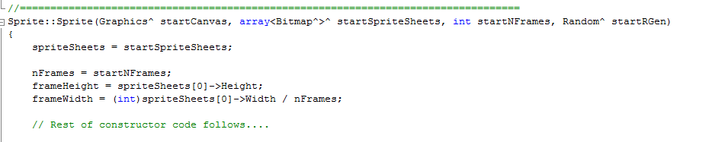
Modify the Class Methods
Constructor:
Notes:
Two approaches possible:
1) pass in an array of Bitmaps
2) pass in an array of filenames and let the sprite create his Bitmaps
Let’s look at both.
Here’s the “pass in the bitmaps” way
You are sent in a pointer to a preloaded array, and you just grab the address it holds
Alternatively, the “pass in filenames” way….

Slide 7
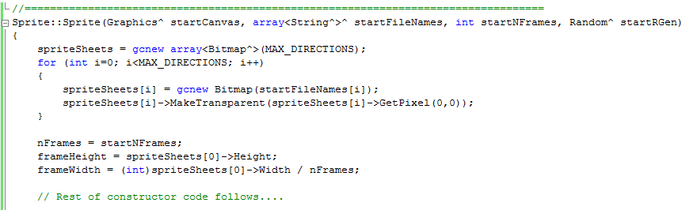
Modify the Class Methods
Constructor:
Notes:
Here’s how to do it if you pass in an array of image file names
You will need to allocate space for the Bitmap array and create the bitmaps in the constructor, as shown.
From an architectural perspective, you might prefer the latter. Why?
To see why, think about what the form must do in each case:
Case 1: make the bitmaps from the filenames, set their transparency, bundle them into an array, pass the array
Case 2: put the filenames into an array, pass the array
In Case 1, the Form knows a lot more about the Sprite, which violates the separation of classes (decoupling) of good OO.
If you decided to switch from Bitmaps to some other graphics class in the Sprite, you would have to change the code of both the Sprite and the Form with the first solution. This is bad, as touching code gives you a chance to break code.
Change to one class should never (or as rarely as possible) require changing the code of another class. Not only does it introduce more bug chances, but you have to be chasing down all over your project finding all the places that need to be changed. Much better to only have to ever change one class at a time.

Slide 8

Modify the Class Methods
Constructor:
Notes:
You also need to give your new SpriteDirection (or spriteDirection) class data member a default value.
Here is what it might look like if you are using Properties and and enum.
If you are using set/get and #defines, it would be spriteDirection = EAST;

Slide 9
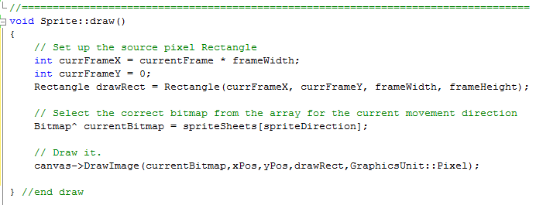
void Sprite::draw()
Notes:
This is the same as before except for the addition of one line of code. The one where we initialise currentBitmap.
With only one sprite sheet, we just worked out the pixel rectangle. This computation is the same
Now with multiple sprite sheets, we must also select the correct Bitmap to pass into the DrawImage command
We will set spriteDirection to EAST, WEST, etc. in the keyDown handler (did you figure this out yet?)
If we place our sprite sheets into the array correctly, we can use this to select the correct Bitmap
Assuming EAST 0 and around clockwise, how do we then do this? Put the East-facing sheet into position 0, the south-facing sheet into position 1, etc.

Slide 10
void Sprite::move()
Velocities need to be separated into a magnitude and a direction
Let xVel and yVel now represent the magnitude of a single step.
They will always be positive.
Add direction properties to control the horizontal (x) and vertical (y) direction of movement.
Direction values = {-1, 0 , 1}
One direction value for x (horizontal) movement and one for y (vertical) movement.
To control the axis (direction) of movement, multiply the velocities by their direction values.
Add the results to xPos and yPos.
Notes:
This is the tricky one. We need to move the sprite (i.e. change its xPos and yPos) in the correct direction.
(On board before slide)
We want to continue with xPos+=xVel and yPos += yVel, we now need to have the correct values to add to xPos and yPos in our move
Let’s start first thinking only abour East/West movement (so yVel= 0 and doesn’t matter). You will easily be able to expand the logic to include North/South.
So far, since our move was xPos += xVel, if we wanted to move East we made xVel positive, say 5. If we wanted to move West, we multiplied xVel by -1, changing it to -5. That way, we could use the same code in the Move (better than trying to sometimes add and sometimes subtract).
If you try to do directional movement by changing xVel, you will spend a lot of time toggling and your code will get messy.
A more elegant solution can be achieved by recognising that there are really two components to the Sprite’s velocity: the size (magnitude) of the step, and the positive or negative direction of the step.
In our above example, the size was always 5, the direction for East was positive and the direction for West was negative.
The total movement is achieved by taking magnitude times direction and incrementing xVel by that amount. (5 * -1) or (5 * +1).
You can extend this logic to yVel by assuming that you can have a direction of 0. This simplifies your move equation (as we will see in a minute).
Starting now, we are going to break up our velocities into these two components. We will see the implementation advantage of this as we proceed.
(Slide)
Magnitude is how much the sprite moves at each timer tick (i.e. how fast he is going)
Direction is positive/negative on the x-axis and positive/negative on the y-axis
XVel and YVel represent the magnitude of a single “step” when the sprite moves.
From now on THEY WILL ALWAYS BE POSITIVE
So you must adjust their sign (positive or negative) to produce movement in the correct direction along the x and y axes.
Each compass direction has a particular pair of values to adjust the sign as needed => one for the X axis and one for the Y
We multiply our velocities (magnitudes) by these values.
Do examples: (-1,0) = West; (1,1) = SouthEast, etc.
All values shown on next slide

Slide 11
void Sprite::move()
Example:
Assume xVel = 5 and yVel = 5
What are the xDirection and yDirection values to move:
East?
West?
South West?
In each case we would compute:
xPos += (xVel * xDirection)
yPos += (yVel * yDirection)
Notes:
(1,0)
(-1,0)
(-1,1).
South West isn’t in our demo, but those images are available, and you could easily extend this architecture to include them.
you’d just need to come up with something for the user input
When we perform the computation, the sprite moves in the desired direction
If his image shows him facing that way, we have convincing directional movement
Note that you only need one set of statements in your Move method. There is no switch or big mess of if statements.
Those two computations are all that’s required for all directions of movement, assuming you can get the correct values into xDirection and yDirection.
How do we do that?
Let’s look at the values for xDirection and yDirection for each of the four compass directions...

Slide 12
void Sprite::move()
If Direction is | Multiply XVel by | Multiply YVel by
EAST | 1 | 0
SOUTH | 0 | 1
WEST | -1 | 0
NORTH | 0 | -1
Notes:
You could organise your intuitions there into this little table. (Extend for intermediate compass directions when needed.)
How then do you store and use these values? Do you need 8 new data properties for your Sprite: xDirEast, yDirEast, xDirSouth, yDirSouth, etc.?
No.
See this nice table? Whenever you find yourself expressing logic by putting things into a table, you should consider whether an array would help.
In this case, it certainly would.
We don’t want to have to store 8 individual direction variables. In addition to being simply cumbersome, it would be very awkward to switch between them when we changed directions. It would require some large switch statement or if-else
If instead we store the direction variables in a nice array, we can use spriteDirection to index into it exactly as we use spriteDirection to index into the bitmap array. Just put the directions for EAST in location 0, for SOUTH in location 1, etc.
And that is elegant coding.

Slide 13
void Sprite::move()
Assume an array<Point>^ velocityDirections that represents this table:
xPos += xVel * velocityDirections[spriteDirection].X;
yPos += yVel * velocityDirections[spriteDirection].Y;
If Direction is | Multiply XVel by | Multiply YVel by
EAST | 1 | 0
SOUTH | 0 | 1
WEST | -1 | 0
NORTH | 0 | -1
Notes:
Note that Point is a primitive, so no ^ required.
Then the code we require is as shown
Isn’t that cool?
Where do we set up velocityDirections? => In the constructor. This is data that the object needs to know.

Slide 14
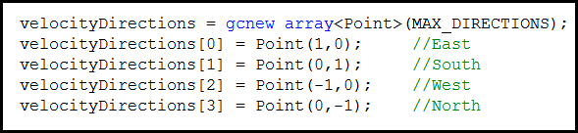
velocityDirections
in Sprite.h
array<Point>^ velocityDirections;
In the constructor in Sprite.cpp
Notes:
Declare in class declaration
Initialise in the constructor

Slide 15
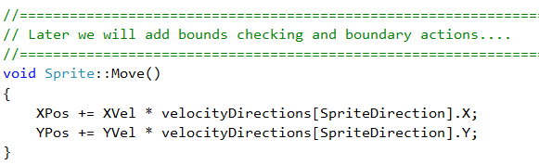
void Sprite::move()
Notes:
xVel and yVel don’t have to change sign all the time. They are always positive.
Note how beautiful this is. No if statements. It works for as many directions as you need – just extend the array as required
Note that you are not seeing all of the code in my move method.
I’ve got some bounds checking as well. We will discuss next time.

Slide 16
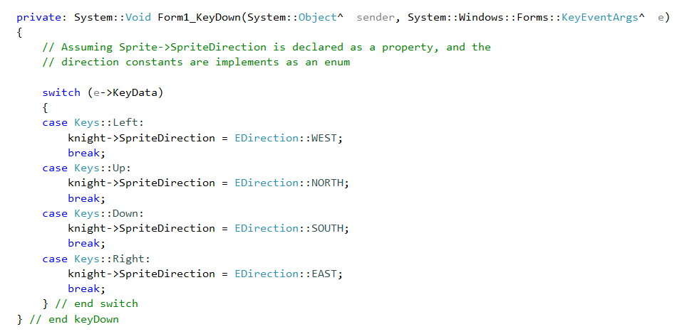
Controlling spriteDirection
Notes:
Very straightforward
Adjust syntax for #define and/or set/get methods
In this implementation, the erase/move/draw cycle is in the timer, so all that happens here is the change of direction.
Think about how you would modify it to control the sprite’s stepping, as in a platform game.
All the other methods are set up to work off SpriteDirection, so the character will change direction and change images

Slide 17
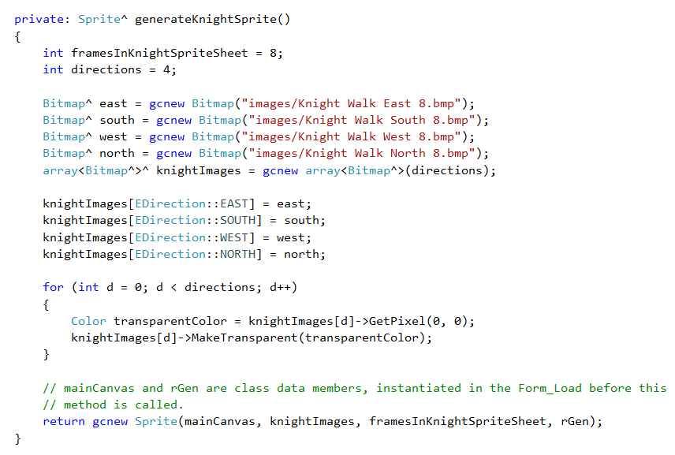
Creation
Notes:
If you use the “pass in bitmaps” approach, you might have a method like this (in the form, or eventually, in the GameManager)

Slide 18
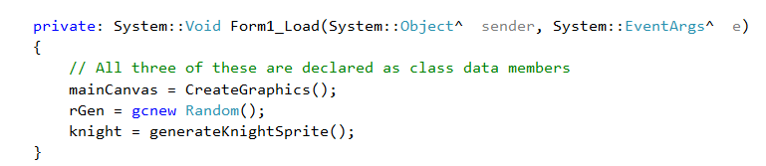
Initialisation
Notes:
This could also happen in a GameManager class if you have one, to which the canvas and rGen have been passed.
Note that it is better to make the assignment to knight explicit like this than to bury it in the generateKnightSprite method.
We try to avoid “hidden side effects”. More on this later.

Slide 19
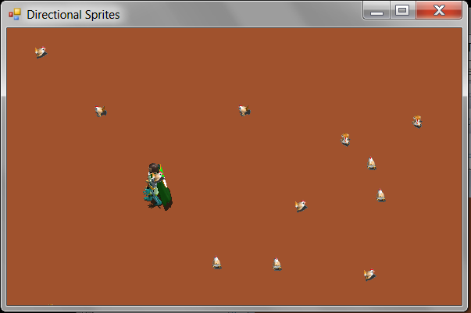
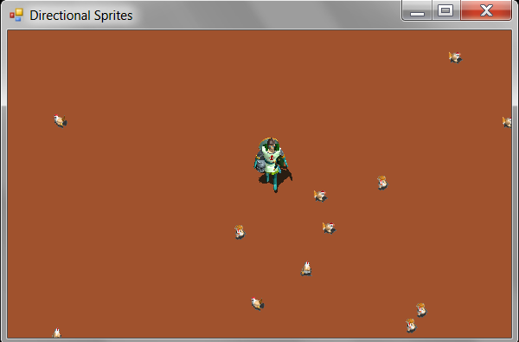
Practical
Notes:
To import existing classes. You MUST do it this way, or your builds will be wrong.
1) Place a copy of the .h and of the .cpp into the folder where Form1.h is
2) Project->Add Existing Item and select them.

